Slide 1
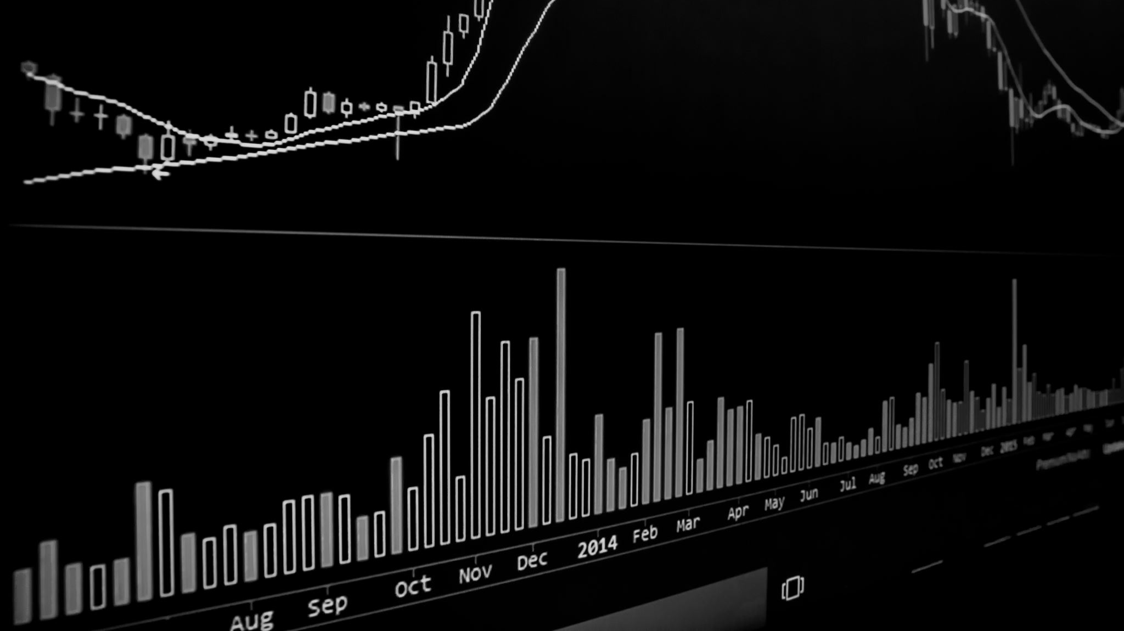
Quantitative Trading Platforms and the Algorithms Used in Finance Industry
XiaoNa Hang
Student ID: 49019378
A powerful Platform for predicting stock trends

Slide 2
Quantitative Trading Platforms, often referred to as "quant“, utilize mathematical and statistical models to comprehend and forecast market behavior. Organizations and Firms in the Finance Industry utilize it to help make decisions in trading stock. This discipline has two major areas: 1. Quant Platforms 2. Quant Research

Slide 3
Quant Platforms - Design and trade algorithmic trading strategies directly in the web browse. QuantConnect - Offers a cloud-based platform for strategy development, backtesting, and deployment across multiple asset classes. - Unified API: Access a cutting-edge, unified API - Explore algorithms, and machine learning libraries and quantify factor importance through terabytes of financial data. - Offer the Live Trading function

Slide 4
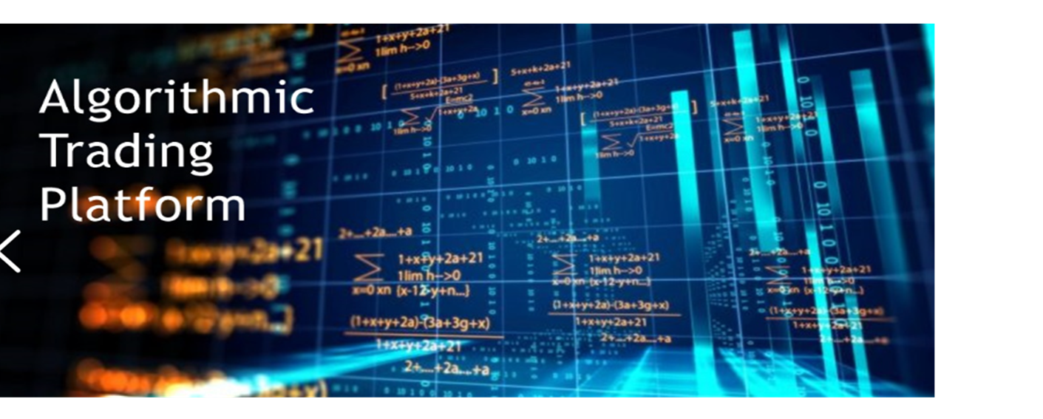







Quantitative Researchers - In the last two decades, MBAs and Ph.D. holders not only in finance, but also in Computer Science, and even Neural Networks have taken traders' jobs at reputable trading institutions.

Slide 5
The Simple Moving Average (SMA)
A powerful tool for predicting stock trends

Slide 6


Simple Moving Average (SMA)
SMA or Simple Moving Average is a widely used technical analysis tool used in finance to calculate the average price of an asset over a period of time. SMA is used in trading to identify trends and predict future price.
SMA is calculated by adding up the closing prices of a security over a specified period and then dividing that sum by the number of periods.
It is often used to indicate trend analysis and support/resistance levels in technical analysis movements of a financial asset. SMA is easy to calculate and understand, but it can be slow in detecting sudden changes in price trends.
𝑃𝑛 = The price of an asset at period 𝑛
𝑛 = The number of total periods

Slide 7
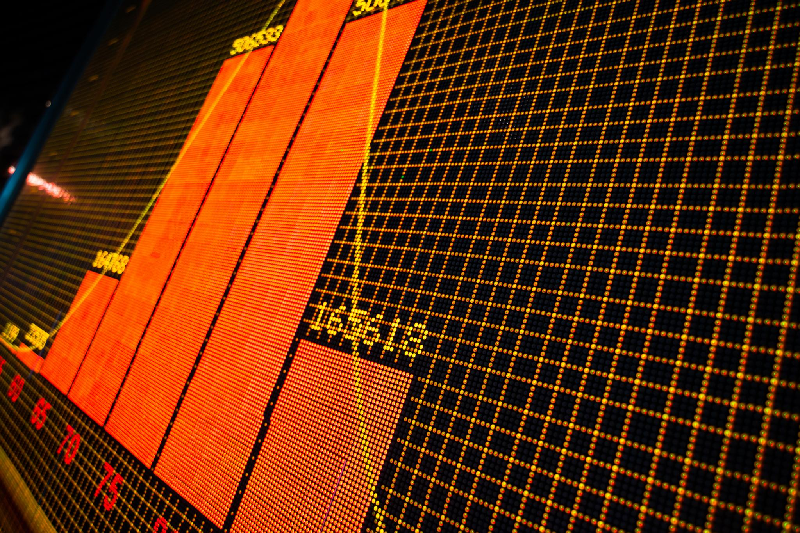
SMA as a Trading Strategy
SMA trading strategies include:
The crossover strategy is used to identify changes in trend and potential entry and exit points by using two different period SMAs, short and long-term SMA to buy or sell.
The price action strategy is used as a support or resistance level for securities. Traders can enter or exit positions when the security price crosses above or below the SMA.
The support & resistance strategy involves using breakouts to enter or exit positions. Traders can enter a long position when the price breaks through the SMA and closes above it, or a short position when the price breaks through the SMA and closes below it.
Bull Market
A market condition where stock prices are rising, and investor confidence is high. The 20-day SMA is used if price crosses above the SMA, it is a potential buy signal, and if price crosses below, it can be a potential sell signal.
Bear Market
A market condition where stock prices are falling, and investor confidence is low. The 50-day SMA identifies trends and potential entry and exit points during a bear market.

Slide 8
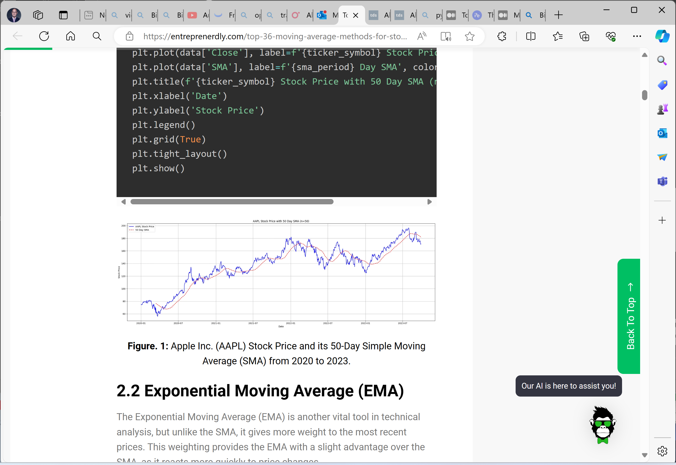
Python Code and Chart for Simple Moving Average (SMA)
# Required Libraries
import yfinance as yf
import matplotlib.pyplot as plt
import pandas as pd
# Fetch data
ticker_symbol = "AAPL"
data = yf.download(ticker_symbol, start="2020-01-01", end="2024-01-01")
# Calculate SMA
sma_period = 50 # Example: 50 days SMA
data['SMA'] = data['Close'].rolling(window=sma_period).mean()
# Plot
plt.figure(figsize=(20,7))
plt.plot(data['Close'], label=f'{ticker_symbol} Stock Price', color='blue')
plt.plot(data['SMA'], label=f'{sma_period} Day SMA', color='red', linestyle='--')
plt.title(f'{ticker_symbol} Stock Price with 50 Day SMA (n={sma_period})')
plt.xlabel('Date')
plt.ylabel('Stock Price')
plt.legend()
plt.grid(True)
plt.tight_layout()
plt.show()
Notes:
Three stacks.
Data from Yahoo.
The red line is the simple moving average.
Use the information to go the next slice.

Slide 9
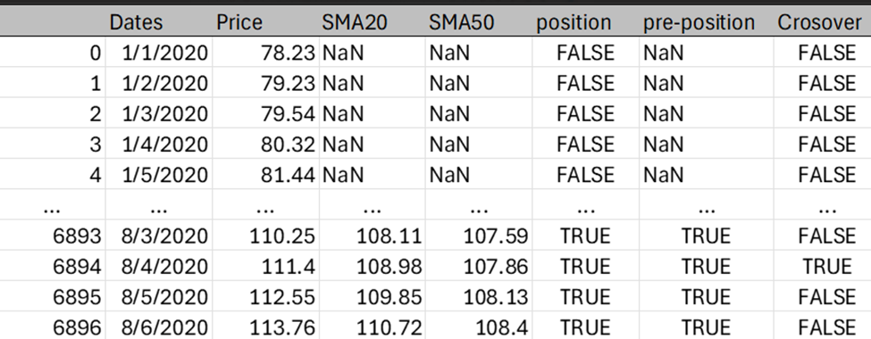
Defining Crossovers
# calculate windows of sizes 20 & 50
SMA20 = ticker_symbol ['Close'].rolling(window = 20).mean() SMA50 = ticker_symbol ['Close'].rolling(window = 50).mean()
# find data points where shorter-term line is above the longer-term line
def get_points_above(sma_low, sma_high): points_above = {} for pair in zip(sma_low, sma_high): if pair[0] >= pair[1]: date = sma_low[sma_low == pair[0]].index[0] points_above[date] = pair[0] points_above = pd.Series(points_above, name='Price_Points') points_above.index.name = 'Date' return points_abovepoints_above_SMA50 = get_points_above(SMA20, SMA50)
# reset the index for frames - dates become a new column
SMA20 = SMA20.reset_index() SMA50 = SMA50.reset_index()
# crossovers data frame contains points where the shorter-term SMA line crosses above or below the longer-term SMA line
crossovers = pd.DataFrame()crossovers['Dates'] = SMA20['Date'] crossovers['Price'] = [i for i in ticker_symbol['Close']] crossovers['SMA20'] = SMA20['Close'] crossovers['SMA50'] = SMA50['Close']crossovers['position'] = crossovers['SMA20'] >= crossovers['SMA50'] crossovers['pre-position'] = crossovers['position'].shift(1) crossovers['Crossover'] = np.where(crossovers['position'] == crossovers['pre-position'], False, True) crossovers['Crossover'][0] = False print(crossovers)
Notes:
Segment P
P before, p after

Slide 10
Acting on Crossover Signals
# create a Signal = English Output of Buy/Sell and Binary_Signal = 1 = Buy and 0 = Sell
crossovers = crossovers.loc[crossovers['Crossover'] == True] crossovers = crossovers.reset_index() crossovers = crossovers.drop(['position', 'pre-position', 'Crossover', 'index'], axis=1) crossovers['Signal'] = np.nan crossovers['Binary_Signal'] = 0.0
for i in range(len(crossovers['SMA20'])): if crossovers['SMA20'][i] > crossovers['SMA50'][i]: crossovers['Binary_Signal'][i] = 1.0 crossovers['Signal'][i] = 'Buy’ else: crossovers['Signal'][i] = 'Sell’
print(crossovers)
References:
https://www.investopedia.com/articles/active-trading/111214/quants-what-they-do-and-how-theyve-evolved.asp#toc-what-are-the-steps-to-become-a-quant
Top 36 Moving Average Methods For Stock Prices in Python - Entreprenerdly
Notes:
Crossover has a lot of information.
In Quantitative Platforms Wrap these basic Move Average algorithms to build the Machine Learning Model. Let the model learn from big size of data to give the prediction

